Slide 1
Forest Fire Prediction Using Machine learning Technique

Slide 2
ABSTRACT:
Forests are an essential natural resource to humankind, providing a myriad of direct and indirect benefits. Natural disasters like forest fires have a major impact on global warming and the continued existence of life on Earth. Automatic identification of forest fires is thus an important field to research in order to minimize disasters. Early fire detection can also help decision-makers plan mitigation methods and extinguishing tactics. This research tells us the early detection of forest fires using rainfall, humidity wind speed, fine fuel moisture code, duff moisture code, drought code and fire weather index. So by using the dataset we had, we develop a model to predict early forest fire prediction.

Slide 3
EXISTING SYSTEM:
Fires caused in forests are known to be one of the most hazardous environmental issues which cannot be neglected. Fast and quick prediction is the only way by which we can at least face it with readily available fire extinguishing resources. To accomplish this one of the best ways is to use automatic tools based on locally placed sensors, such as rain, thermal readings, relative dampness and wind. In this work, we inquire a Data Mining (DM) approach to predict the area prone to forest fire. SVM (Support Vector Machine) algorithm is used for live sensor data. SVM algorithm utilizes four sensor inputs related to weather info data (i.e. thermal data, relative dampness, rain and wind velocity) and it is feasible to predict the burned land zone due to small fires, which are periodic or frequent. Awareness about those zones are utilized for developing and deploying fire fighting resource management. The data received from the sensor devices are processed in individual fog nodes and the cumulative data is collected upon and is used for further analysis. The data transfer happens wirelessly via Zig-Bee tool. The results obtained is utilized to predict the areas which are prone to and will be affected by sudden outburst of forest fire.

Slide 4
Drawbacks:
They are using machine learning with less parameters
The implementing algorithm shows low accuracy.
They have not mentioned any metrics reports.

Slide 5
PROPOSED SYSTEM:
The proposed system will predict the most suitable crop for particular land based on soil contents and weather parameters such as Temperature, Humidity, Soil PH, Nitrogen, Phosphorus, and Rainfall. Data collection is the most efficient method for collecting and measuring data from different resources. After collecting datasets from various resources, the dataset must be preprocessed before training to the model. The data preprocessing can be done in various stages, beginning with reading the collected dataset the process continues to data cleaning. In data cleaning the datasets contain some redundant attributes, those attributes are not considered for crop prediction. So, we have to drop unwanted attributes and datasets containing some missing values. we need to drop these missing values or fill them with unwanted nan values in order to get better accuracy. Statistical algorithms and machine learning techniques to identify future outcomes based on historical data. The goal is to go beyond knowing what has happened to provide the best assessment of what will happen in the future. In our system, we used a supervised machine learning algorithm having subcategories as classification and regression. The classification algorithm will be most suitable for our system.

Slide 6
Advantages:
We are using the machine learning technique for getting better predictions.
More than two machine learning algorithms are compared.
They didn’t calculate the accuracy and performance metrics.
Deployment is done here.

Slide 7
LITERATURE REVIEW:
LITERATURE REVIEW:
General
In the present world the farming is neglected and everyone is moving into modernization. No one don’t know how to do farming
Review of Literature Survey
Title: Data mining approach to predict forest fire using fog computing
Author: Aakash Rajagopal S
Year: 2018
Fires caused in forests are known to be one of the most hazardous environmental issues which cannot be neglected. Fast and quick prediction is the only way by which we can at least face it with readily available fire extinguishing resources. To accomplish this , one of the best ways is to use automatic tools based on locally placed sensors, such as rain, thermal readings, relative dampness and wind. In this work, we inquire a Data Mining (DM) approach to predict the area prone to forest fire. SVM (Support Vector Machine) algorithm is used for live sensor data. SVM algorithm utilizes four sensor inputs related to weather info data (i.e. thermal data, relative dampness, rain and wind velocity) and it is feasible to predict the burned land zone due to small fires, which are periodic or frequent. Awareness about those zones are utilized for developing and deploying fire fighting resource management . The data received from the sensor devices are processed in individual fog nodes and the cumulative data is collected upon and is used for further analysis. The data transfer happens wirelessly via Zig-Bee tool. The results obtained is utilized to predict the areas which are prone to and will be affected by sudden outburst of forest fire. Keywords—Internet of Things (IoT), Fog based computing, Canadian Forest Fire Index, Support Vector Machine (SVM).

Slide 8
LITERATURE REVIEW:
Title: Artificial Intelligence for Forest Fire Prediction
Author: George E.Sakr, Imad H. Elhajj, George Mitri and Uchechukwu C. Wejinya
Year: 2010
Forest fire prediction constitutes a significant component of forest fire management. It plays a major role in resource allocation, mitigation and recovery efforts. This paper presents a description and analysis of forest fire prediction methods based on artificial intelligence. A novel forest fire risk prediction algorithm, based on support vector machines, is presented. The algorithm depends on previous weather conditions in order to predict the fire hazard level of a day. The implementation of the algorithm using data from Lebanon demonstrated its ability to accurately predict the hazard of fire occurrence. Index Terms Machine Learning, SVM, Forest Fire Prediction.

Slide 9
LITERATURE REVIEW:
Title: PREDICTING FOREST FIRES WITH DIFFERENT DATA MINING TECHNIQUES
Author: Madhurima De, Linika Labdhi, Bindu Garg
Year: 2020
Forest fires are one of the most frequently occurring disasters in recent years. The behaviour of forest fire and its severity result from a combination of factors such as available fuels, physical setting, and weather. Analysis of historical meteorological data and national fire records in western North America show the primacy of climate in driving large regional fires via wet periods that create substantial fuels, or drought and warming that extend conducive fire weather. The effects of forest fires creates a very lasting impact on the environment as it leads to deforestation and global warming, which is also one of its major cause of occurrence. Forest fires are dealt by collecting the satellite images of forest and if there is any emergency caused by the fires then the authorities are notified to mitigate its effects. In this work, we will be exploring various Data Mining (DM) approaches to predict the burnt area of forest fires. Five different DM techniques, e.g. Support Vector Machines (SVM) and Random Forests, and four distinct feature selection setups (using spatial, temporal, FWI components and weather attributes), were tested on recent real-world data. Index Terms: Forest Fires, Support Vector Machine, Supervised Learning Algorithms, Data Mining Application.

Slide 10
Aim:
The goal in Forest fires prediction is to provide additional data, from weather reports like rainfall, humidity wind speed, fine fuel moisture code, duff moisture code, drought code and fire weather index, to provide useful information for regional analysis on forest fire risk.
Objectives:
To increase the effectiveness of forest fire prediction. So that we can prevent forest in that area.

Slide 11
LIST OF MODULES:
Data Pre-processing
Data Analysis of Visualization
Implementing CATBOOST
Implementing SCM
Implementing RFC
Implementing Logistic Regression
Deployment

Slide 12
Environmental Requirements:
Software Requirements:
Operating System : Windows 10 or later
Tool : Anaconda with Jupyter Notebook
Hardware requirements:
Processor : Intel i3
Hard disk : minimum 10 GB
RAM : minimum 4 GB

Slide 13
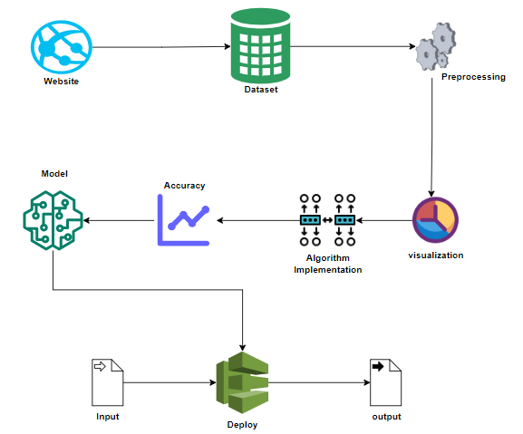
System Architecture:

Slide 14
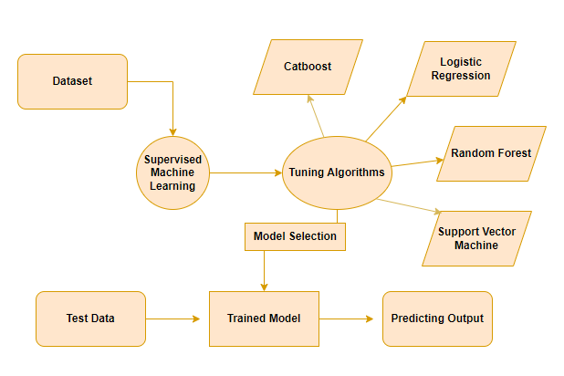

Slide 15
Conclusion:
The analytical process started from data cleaning and processing, missing value, exploratory analysis and finally model building and evaluation. The best accuracy on Forest fire prediction set of higher accuracy score algorithm will be find out. The founded one is used in the application which can help to know in which conditions forest fire will starts.

Slide 16
Future Work:
Deploying the project in the cloud.
To optimize the work to implement in the IOT system.

